Slide 1
Introduction to Exponent Rules and Functions
Annette Robinson
Cassie Mcfarland
Jose Arriola
Notes:
Learner content interaction for Module one
Consisted of 5 exponent formulas presented individually
With one-minute videos that I made using adobe software.
I kept the videos simple with bright colors and trying to follow
Mayer’s principles of multimedia design.
Like the Coherence Principle
Signaling
Redundancy, etc
Each video was followed by a quiz designed with the
Behavioral learning theory.
Here the student receives feedback in real time (positive reinforcement or corrective reminder).

Slide 2
The Course
The topic
Target audience
Learner-content interaction
Learner to learner interaction
Teacher to student interaction
Examples of student interactions

Slide 3
Topic Algebra 2
Target students
Algebra 2 students, grades 10-12
Learning Objectives
After the unit students will be able to:
Understand the rules of exponents
Recognize the situations in which each
exponent rule applies
Describe the function of an exponent
Model exponential growth and decay

Slide 4
Learner-Content Interaction (L-C)
Technology
Storyline 360
Module 0
Example
Theory
A pre-assessment quiz was created using Articulate Quizmaker and Storyline.
We created a private Diigo.com group and posted resources from Khan Academy and Virtual Nerd to initiate a course-focused social bookmarking activity.
Notes:
Designing L-C interaction was initially a challenge in this course – our SME was unable to continue so we had to scramble a little to focus in on manageable and effective content.
Another challenge was attempting to embed Articulate activities in the course; SCORM (Sharable Content Object Reference Model) would have enabled playing and grading the pre-assessment quiz within the course. As SCORM was not available in the free version of Canvas, we worked around it by linking the student to Articulate Online and instructing them to return to the Canvas activity and submit a comment stating their name and "I have taken the assessment".
The Diigo activity was suggested by the Ko & Rossen textbook. (2017, pp. 72-73)

Slide 5
Learner-Content Interaction (L-C)
Technology
After Effects and Storyline 360
Module 1
Example
Theory
This module design breaks down the content in small one-minute videos that use as much as possible Mayer’s principles of media design.
Each video is followed by small quizzes. Following the behavioral learning theory, these quizzes allow the student to receive immediate feedback after each answer to either reinforce or correct the student’s understanding of the exercise.
Notes:
Learner content interaction for Module one consisted of 5 exponent formulas presented individually with one-minute videos that I made using adobe software.
I kept the videos simple with bright colors and trying to follow Mayer’s principles of multimedia design, like the Coherence Principle, Signaling, Redundancy, and other concepts that we learned in this class.
Each video was followed by a quiz designed with the Behavioral learning theory in mind. Here the student receives feedback in real time (positive reinforcement or a corrective reminder).

Slide 6
Learner-Content Interaction (L-C)
Technology
Module 2
Example
Theory
The Learner-Content resources published in Module Two consisted of a video lecture put together by the instructors, a reading article on the topic and a short 5 question multiple choice quiz.
Notes:
We consider the L-L elements of the course were very successful. Our students were actively interacting in discussions (though this tapered off towards the end of the course, as did other activities). There was also L-L interaction in the Diigo and Padlet external activities.
Mention Mayer’s Design principles. Specifically principles such as
Pre-training Present characteristics of key concepts before lesson
Temporal contiguity Present spoken words at same time as corresponding graphics
Personalization - Put words in conversational style rather than formal style
We also provided a reading selection to cater to different learning preferences of visual and auditory with the video and also a reading to cater to those with that preference.

Slide 7
Learner-Learner Interaction (L-L)
M0: Social Bookmarking
Module 0
Module Zero connected our learners through the Introduction discussion "Who Has Done What?" as well as the social bookmarking activity that continued through the course.
Learners came back here toward the end of the course for a reflection discussion. (Ko & Rossen, 2017, pp. 198, 200)
Notes:
Reflection discussion – learners were able to reflect and discuss together how the activity had gone.
This also provided opportunity for the instructor to get some early feedback/insight into how the students were feeling about this particular activity. (p. 198)

Slide 8
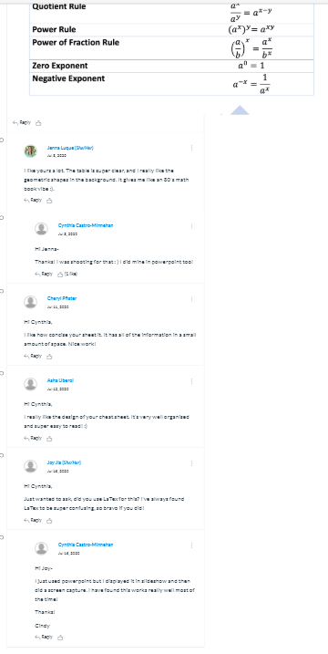
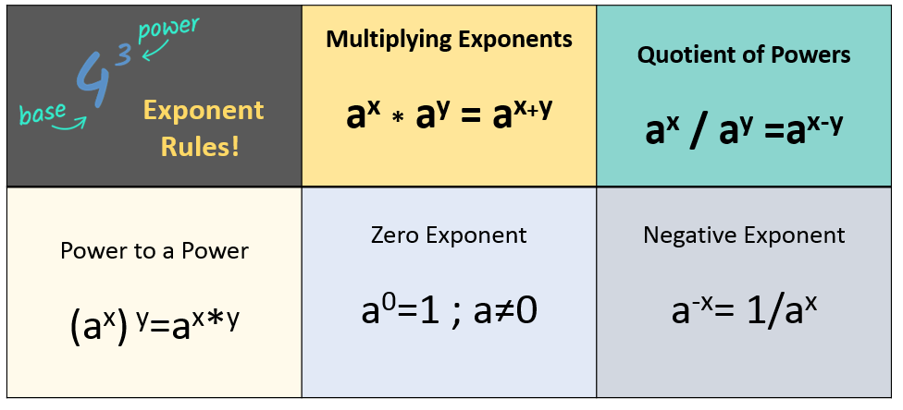
Learner-Learner Interaction (L-L)
M1: Design your own Cheat Sheet
Module 1
Module one asked the students to design their own cheat sheet with any tool available. The students will then share their designs and comment on each other’s work.

Slide 9
Learner-Learner Interaction (L-L)
M2: Social Bookmarking
Module 2
Module Two featured two activities geared towards Learner-Learner interaction, including a discussion board forum as well as an interactive activity utilizing the Padlet platform.
Attached a grading rubric to the discussion board. (Ko & Rossen, 2017, pp. 223-225)
Notes:
Some of the reasoning behind the selection of the learner content activities for module two stems from the section in Ko and Rossen Chapter 10 that addressed some issues that students face with learning style and online communication. Some of the points that I took away from this were that instructors, as well as students should be encouraged to record audio and/or video into courses to make the experience more personal, but that it is important for students to be well equipped with the proper tools to be able to do this if they are expected to do it. I decided to infuse into one of my activities an opportunity for students to record their answer so that classmates could listen to their explanation of how they solved the problems, and in order to ensure that they were well prepared I provided a screencast to model for them how this was done. All students who completed the activity were able to successfully record their audio, so I feel confident in saying that this was a success.

Slide 10
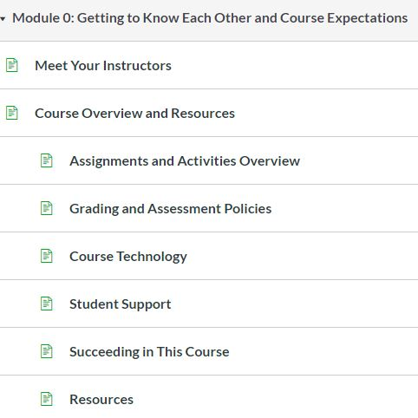
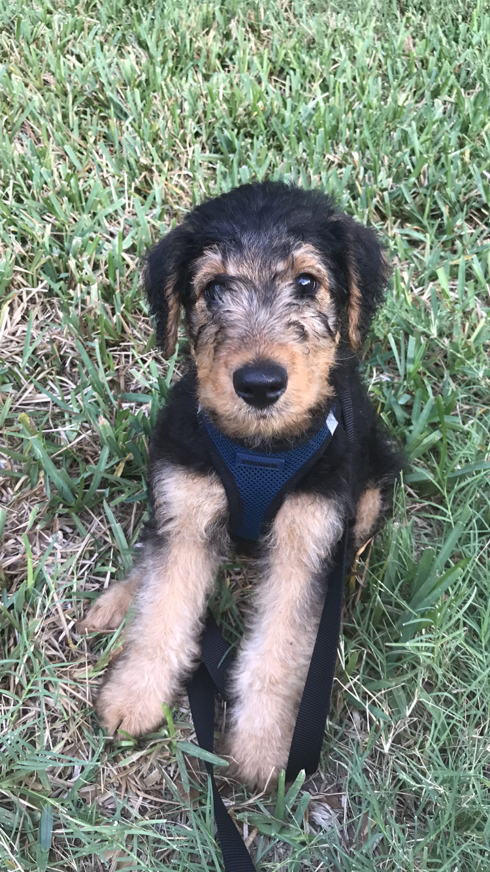
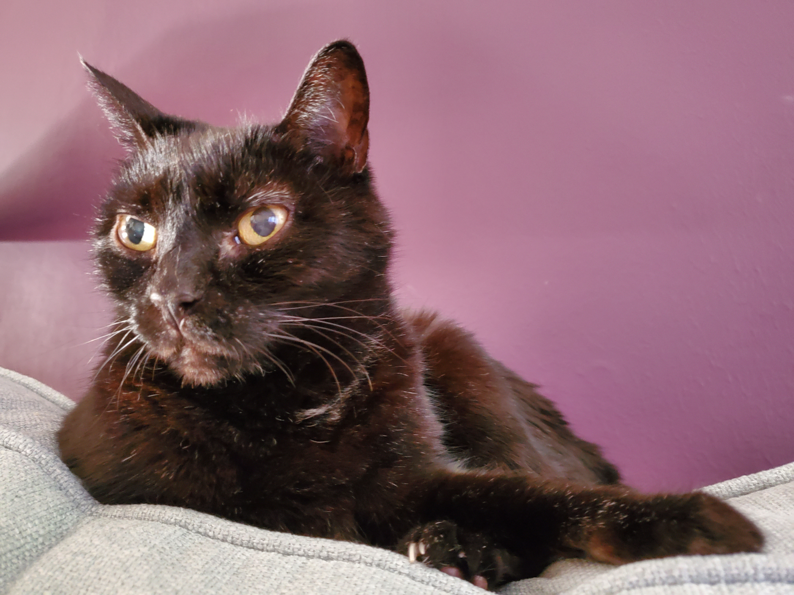
Learner-Instructor Interaction (L-I)
Course Introduction
Course Overview
Meet Your Instructors
Module 0
Instructor Introductions, Course Overview and Syllabus, Course Objectives, Assignments and Activities, Grading Policies, Student Support, Resources, etc. (Ko & Rossen, 2017, pp. 111-137; QM Higher Education Rubric))
Grading rubrics were provided for the Intro discussion and the social bookmarking activity, to assist the students in self-assessment. (Boettcher & Conrad, 2016, p. 245)
A Welcome Announcement was sent to students on the first day.
Discussion Post Rubric
Notes:
As well as sending course announcements through Canvas, we were all available to students via email, and responded with assistance as needed.
We provided feedback through comments when grading.
We worked on making the activity instructions clear.
End of course evaluation:
Instructors were rated Extremely Helpful (2) and Very Helpful (1)
Did the instructors communicate and provide enough feedback?
Yes (2)
Other (1) - "The feedback did not seem specific to my actual work. Also, some of it took a while."
So, we have room for improvement when providing feedback through the grading.

Slide 11
Learner-Instructor Interaction (L-I)
Grading and feedback
Module 1
Module one provided a module overview to let students know what to expect.
Sent out a reminder before the due date for students to complete the activities on time.
Thanked everyone for a great work and their participation.
Provided grades and feedback on time.
Notes:
Boettcher & Conrad (2016), suggests that providing timely feedback encourages cognitive growth, students are eager to get timely feedback and it helps them to incorporate corrections/feedback as well as calm their nerves about how they are doing in the course.

Slide 12
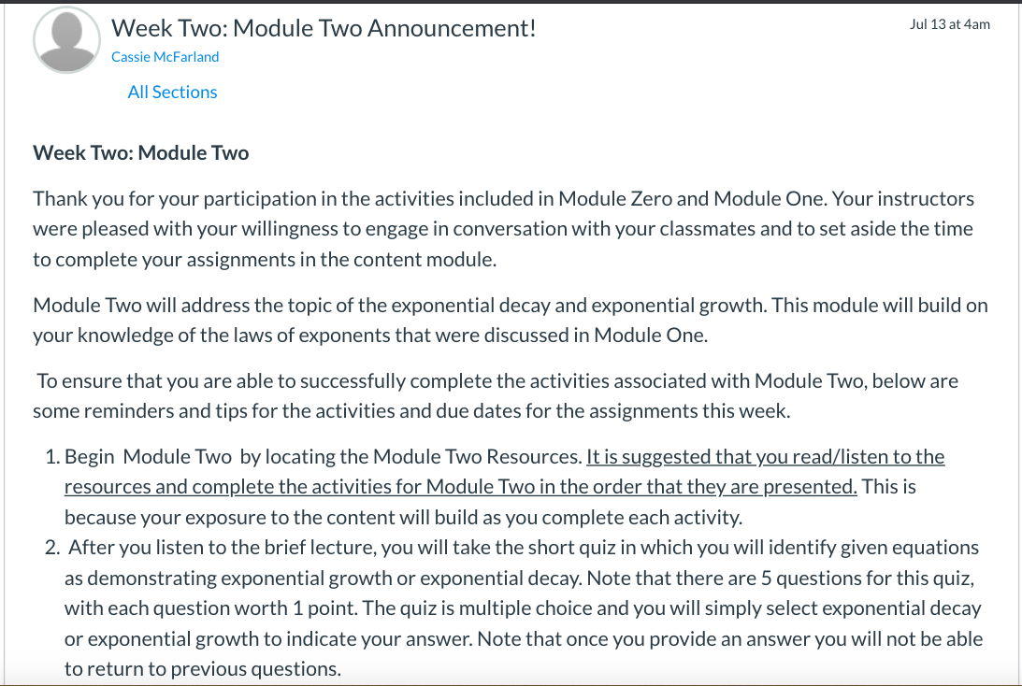
Learner-Instructor Interaction (L-I)
Course Announcement
Module 2
For Module Two, two announcements were sent out, one at the beginning of the week and a reminder announcement approximately halfway through the week to engage students in the activities within the module.
Notes:
We decided to send out announcements at the beginning of not only the course, but also at the beginning of each module. We were inspired to do this from our own positive experiences of sitting in classes where this was done, as well as the information included in Ko and Rossen, our textbook that alluded to the fact that announcements are a great introductory technique that assists in establishing rapport with students. We wanted to send out announcements at the beginning and end of modules so that students felt an ongoing instructor presence throughout the course and to reinforce our willingness to assist them if needed.

Slide 13
Results
Module 3 (feedback module)
Feedback
Canvas analytics

Slide 14
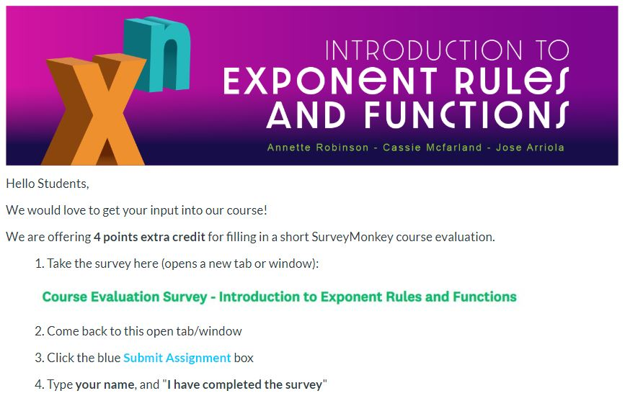
Module 3
We added Module 3 to include a wrap-up activity and course evaluation: Opportunity for students to reflect on what they had learned (schema/cognitive learning)
Notes:
Realizing the importance of ending the course well, and providing the students with opportunity for reflection and feedback, we created a "Just for Fun" wrap-up discussion, and an external (SurveyMonkey) course evaluation survey worth extra credit points. However, Module 3 was opened a little late in the course so only two (out of the 6 active students) contributed to the discussion; however, three students completed the evaluation and provided some good feedback (see next slide).

Slide 15
Course Evaluation Survey
Notes:
Hyperlink the image to the SurveyMonkey results dashboard
https://www.surveymonkey.com/stories/SM-ZLKHRX3D/
The four students who completed the evaluation rated the course highly, overall.
Activity Ratings: Most of the activities were enjoyed; two students struggled with the Diigo activity, and one had some trouble with the Padlet activity. Interestingly, these were both external activities so that might have some bearing; though, one student commented, "I struggled with the activities that involved more interaction. I think it is more about how I view math than the course. Since there is a clear right answer, I found it hard to talk about answers in the way expected."
The suggestion for having a final assessment: This was suggested while we were designing the course

Slide 16
Canvas Analytics

Slide 17
Reflections
Went well
Went wrong
Things to improve

Slide 18
What Went Well
The students who completed the activities seemed to do so correctly and without needing additional instructions or clarification on how to complete the assignments. This let us know that our directions were clear to most students.
A majority of students were engaged and interacting.

Slide 19
What Went Wrong
A couple of students had difficulty navigating to the external social bookmarking activity. They reached out through Canvas and we were able to help them quickly. Simpler instructions could help, next time.
We experienced a minor outage with a link to one of the activities in Module 2 but were able to address the issue appropriately.
One issue with the free Canvas for Teachers – a student with no name! She was able to add her name in one area, but the grade sheet had her as a nameless student. This caused some confusion.

Slide 20
Things To Improve
Next time we would like to ensure that we adjust the directions for our activities to include some basic tips/resources on how to use Canvas so that we don't make assumptions about a student's prior knowledge on how to upload photos or post in discussion forums, etc.
Working in an LMS with the SCORM tool enabled would facilitate streamlining outside content like the Articulate pre-assessment quiz.
Having a synchronous session to ensure students can ask questions and instructors can spot areas that need extra clarification and resources.

